Slide 1

In a
Master Gardener’s Garden

Slide 2
Ray Novitske
Simon Bell
Christina Wenks
Kim DiBona
Lynne Pieri-Finn
Michele Bevington
Karen Bell
Janet Scheren
Pat Dickey
Sandra Oliver
Terry Ginda

Slide 3
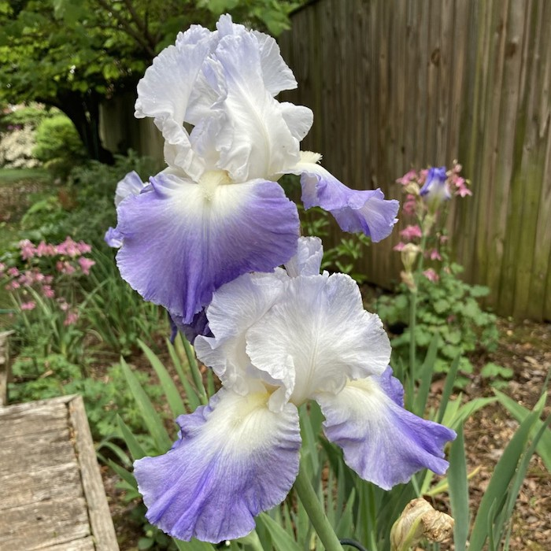
Bearded Iris ’Clarence’
- Ray Novitske

Slide 4
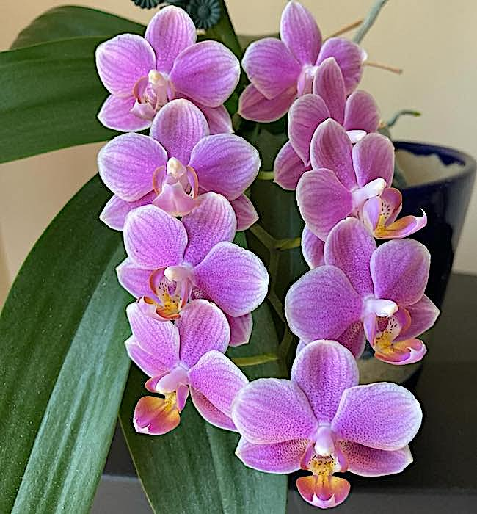
Phalaenopsis Orchid
- Ray Novitske

Slide 5
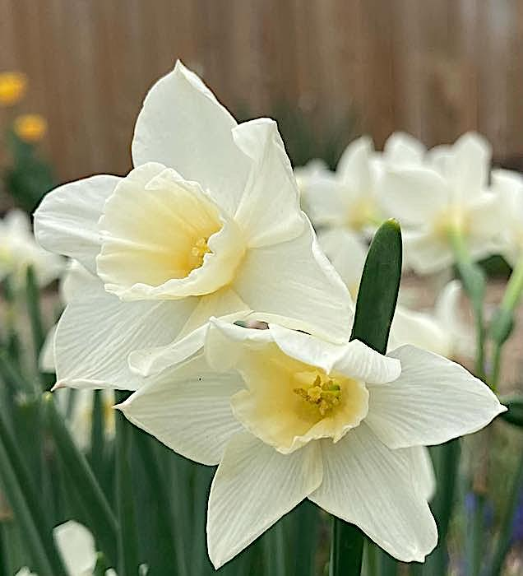
Daffodil ‘Sweet Love’
- Ray Novitske

Slide 6
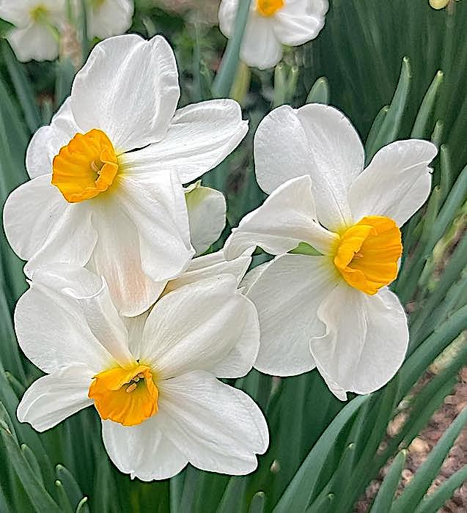
Narcissus Poeticus
- Ray Novitske

Slide 7
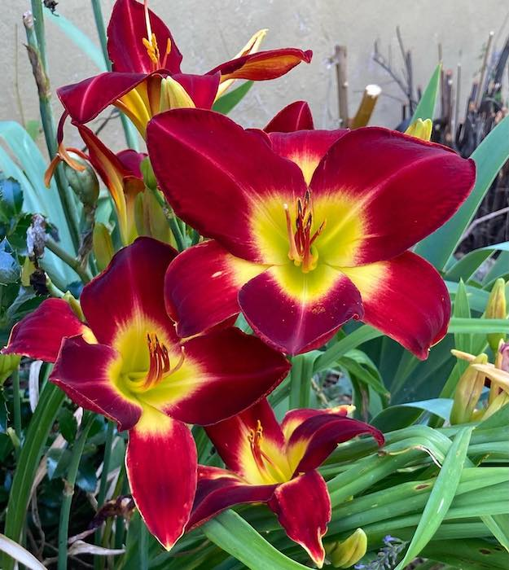
Daylily ’Cherokee Star’
- Ray Novitske

Slide 8
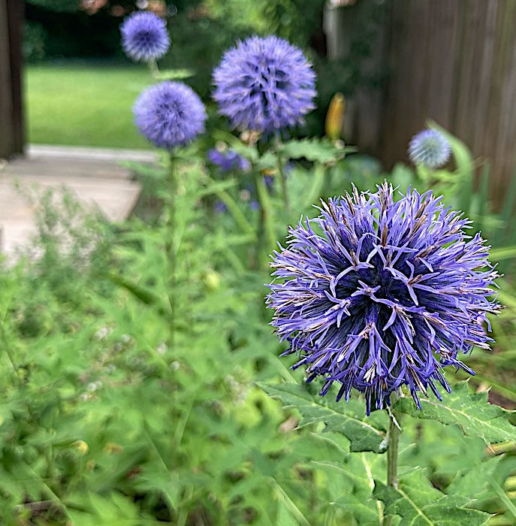
Echinops ritro
- Ray Novitske

Slide 9
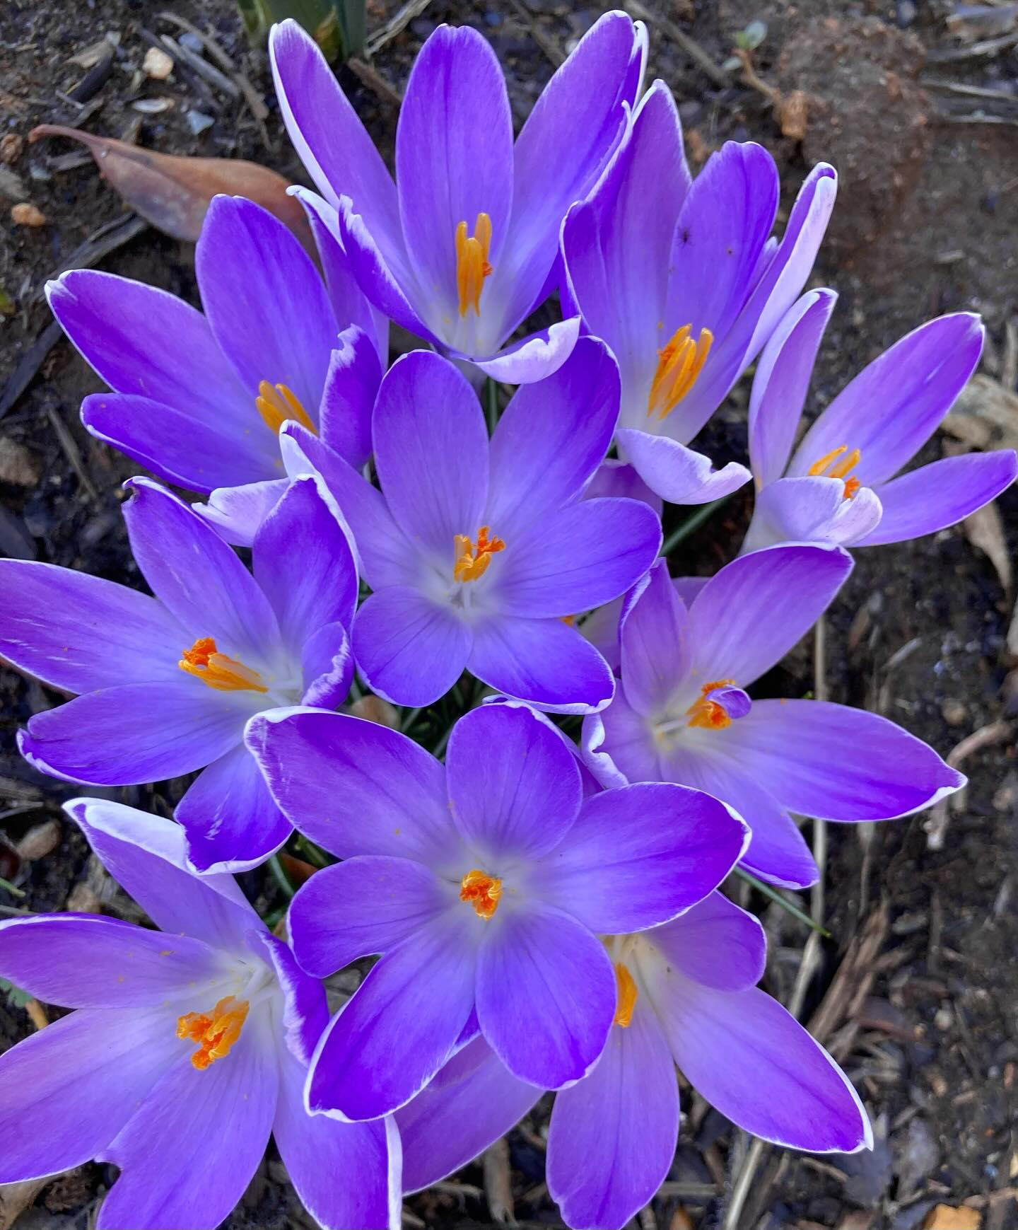
Species Crocus
- Ray Novitske

Slide 10
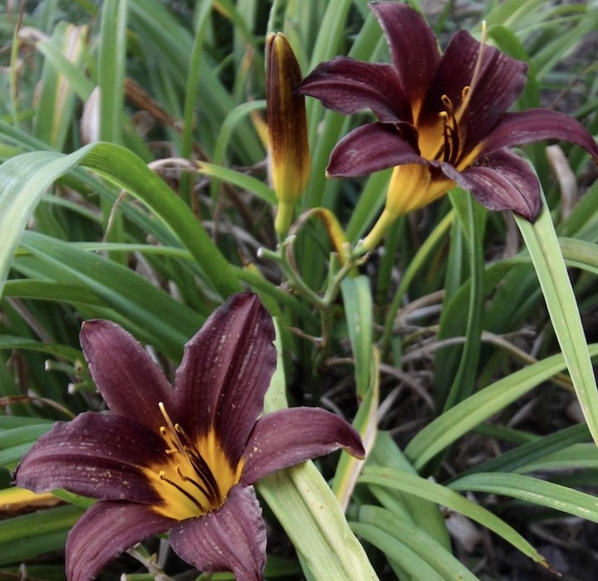
Daylily ‘Midnight Passion’
- Ray Novitske

Slide 11
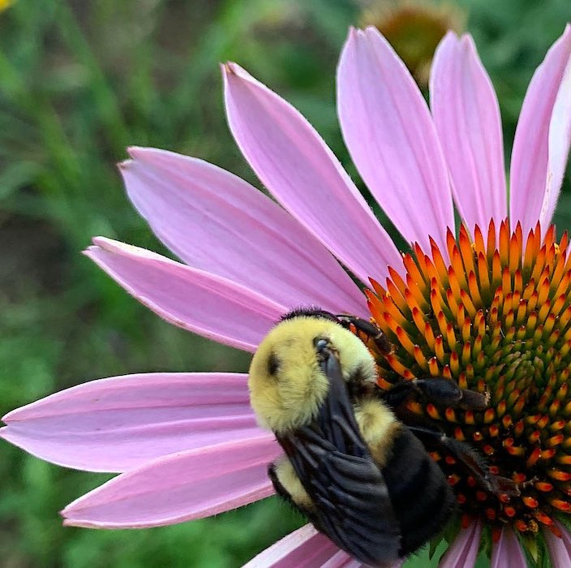
Echinacea and Bumble
- Ray Novitske

Slide 12
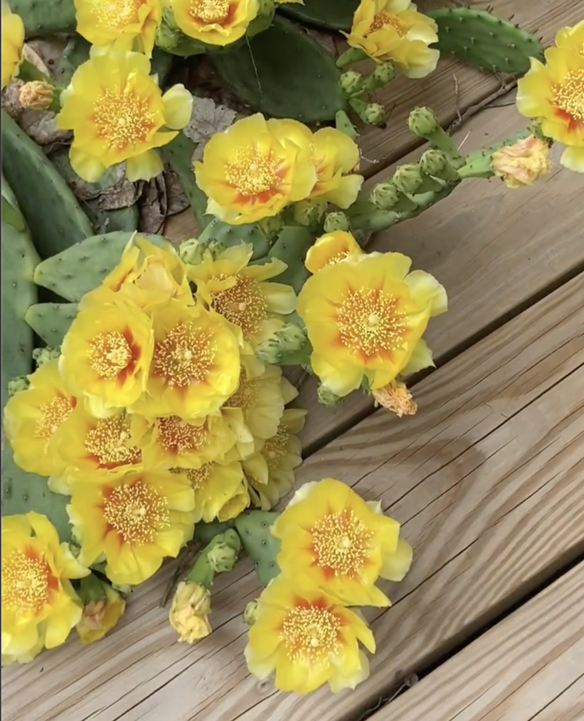
Opuntia
Eastern Prickly Pear Cactus
- Ray Novitske

Slide 13
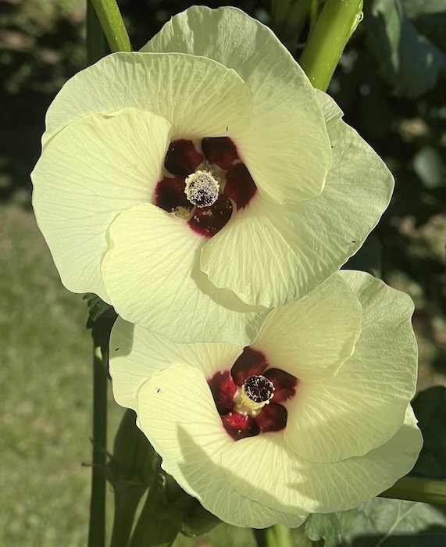
Okra Flowers
- Simon Bell

Slide 14
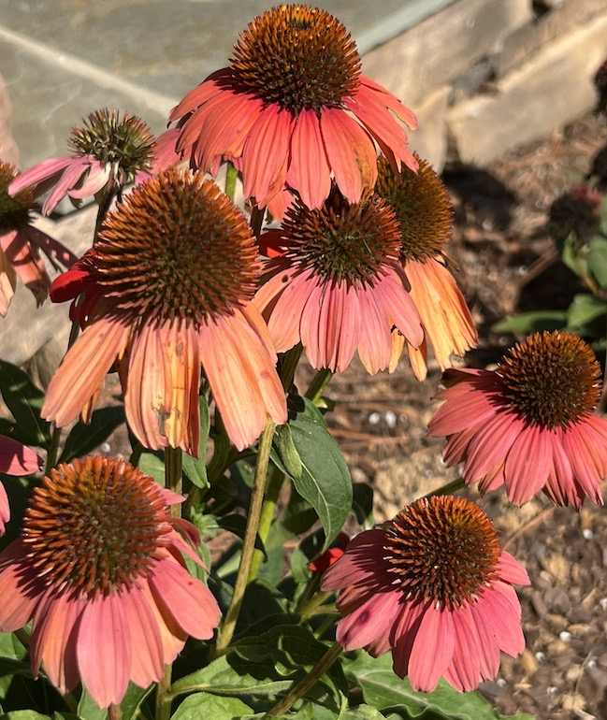
Coneflowers
- Simon Bell

Slide 15
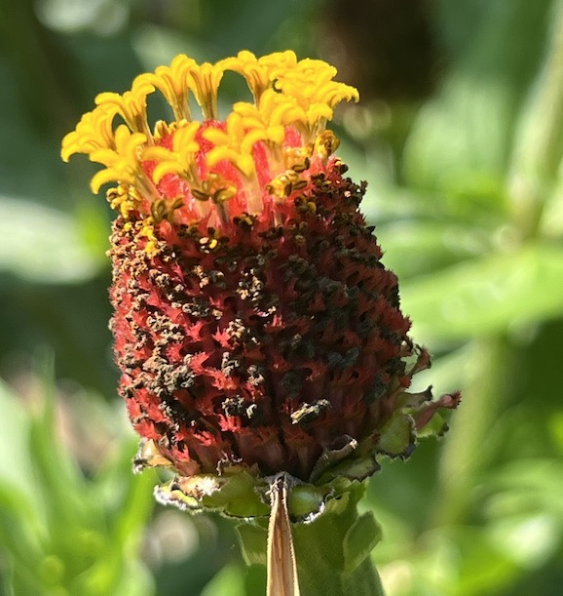
End of the Zinnia
- Simon Bell

Slide 16
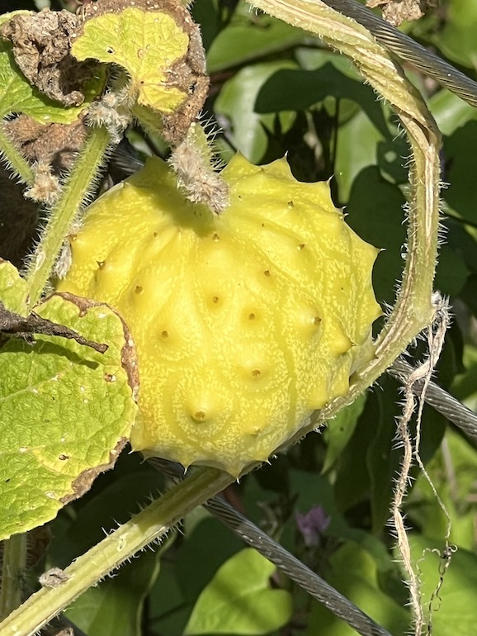
Kiwano Fruit
- Simon Bell

Slide 17
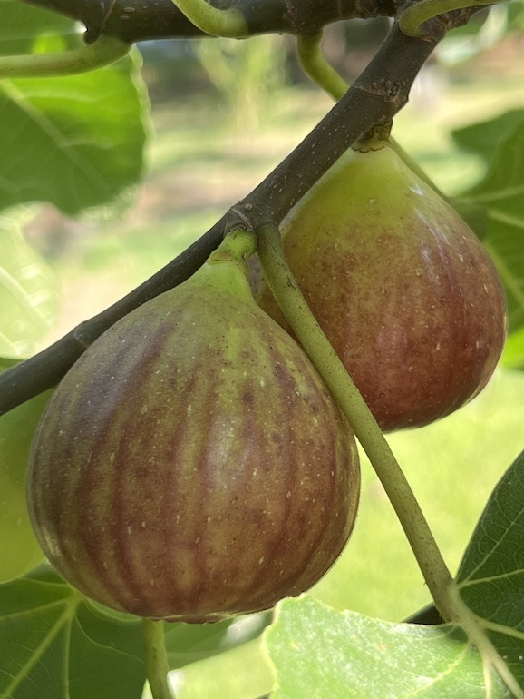
Ripe Figs
- Simon Bell

Slide 18
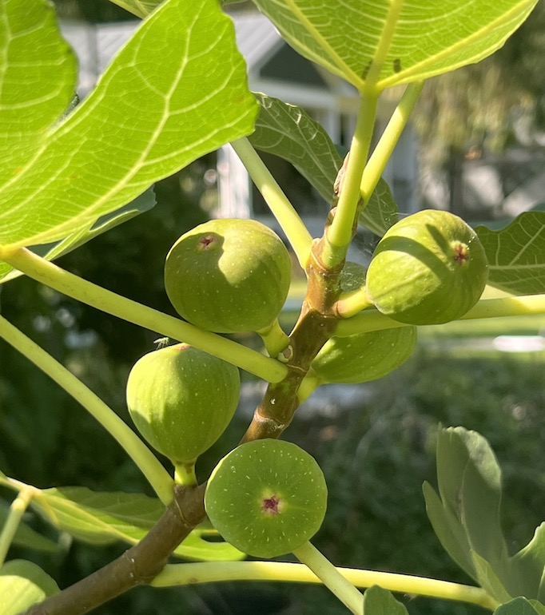
Green Figs
- Simon Bell

Slide 19
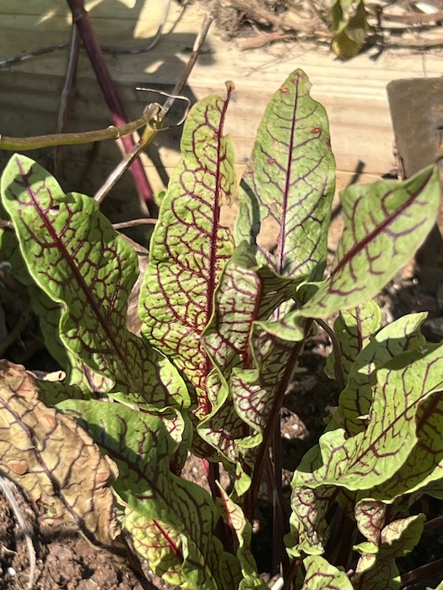
Red Veined Sorel
- Simon Bell

Slide 20
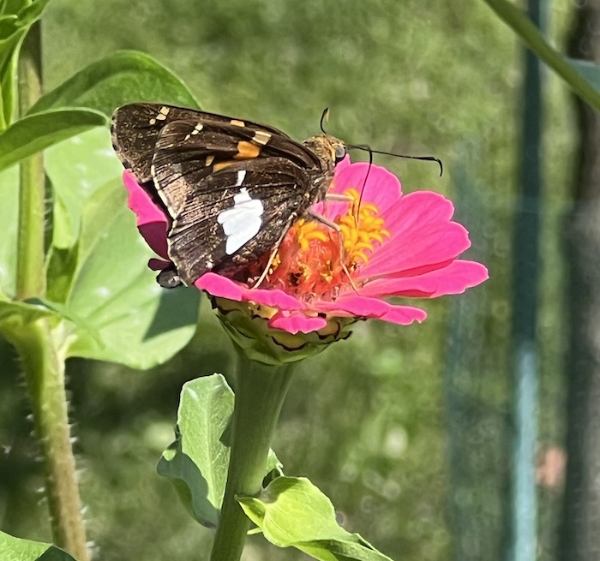
Zinnia with Pollinator
- Simon Bell

Slide 21
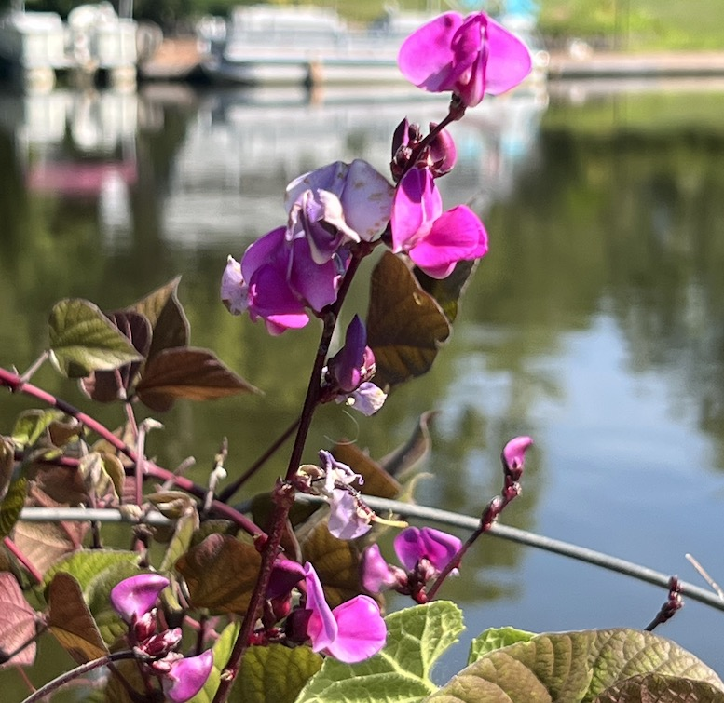
Hyacinth Bean Flower
- Simon Bell

Slide 22
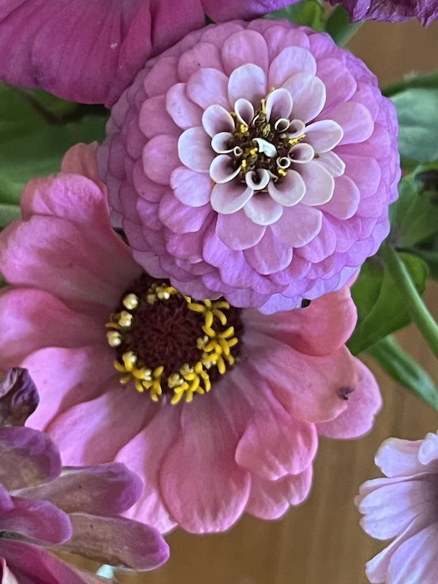
Glorious Zinnias
- Simon Bell

Slide 23
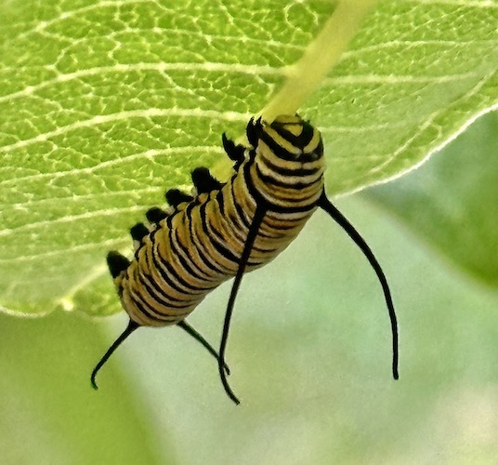
Monarch caterpillar ounching milkweed
- Christina Wenks

Slide 24
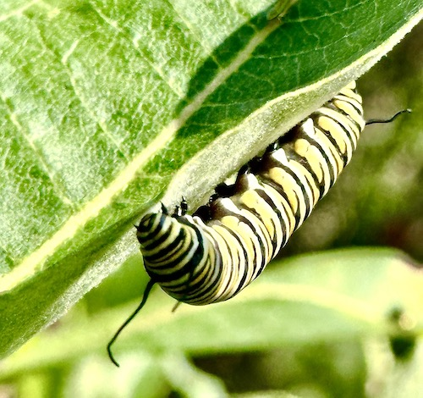
Monarchs on milkweed
- Christina Wenks

Slide 25
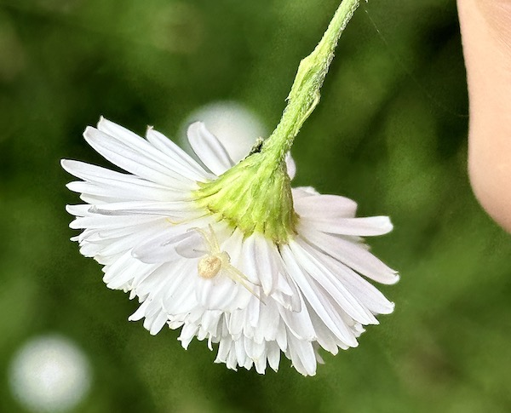
- Christina Wenks

Slide 26
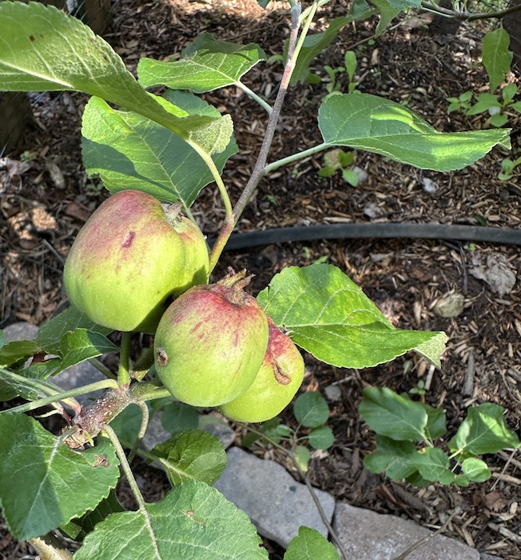
First time getting lots of apples
- Christina Wenks

Slide 27
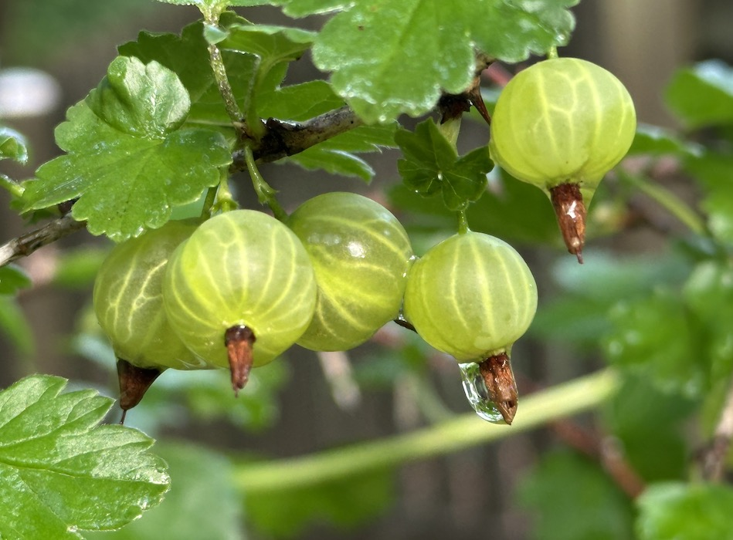
Gooseberries in the garden
- Christina Wenks

Slide 28
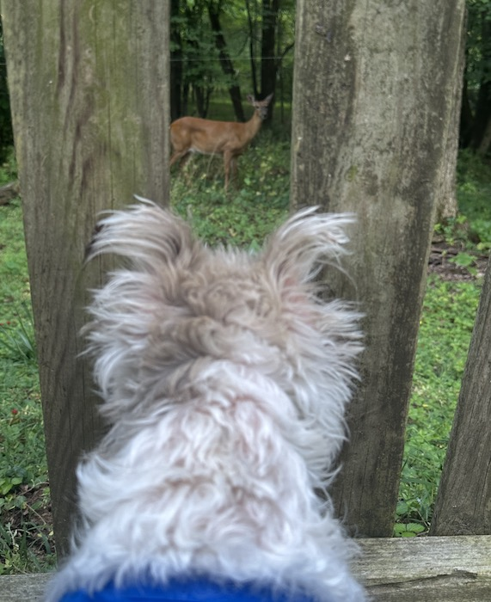
Edelweiss, our furry Apline flower, spots the deer who is responsible for eating all zinnias, azaleas, and asters and birthed two fawns in our garden. The two quietly respect each other’s space.
- Christina Wenks

Slide 29
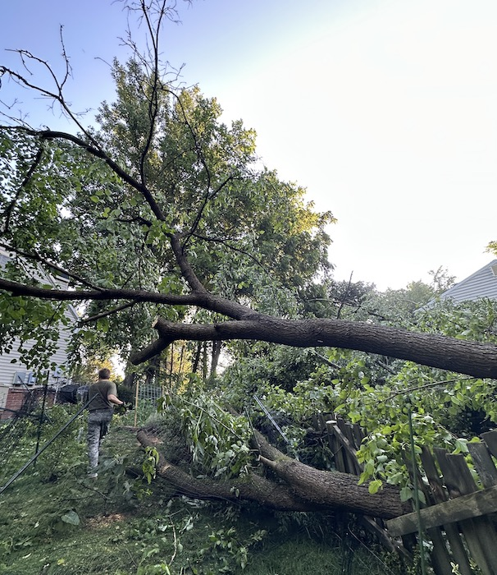
Crushed fence, cherry tree, blueberries, plum tree, fig, and pomegranate because a neighbor chose not to take care of his mulberry with heartwood disease.
- Christina Wenks

Slide 30
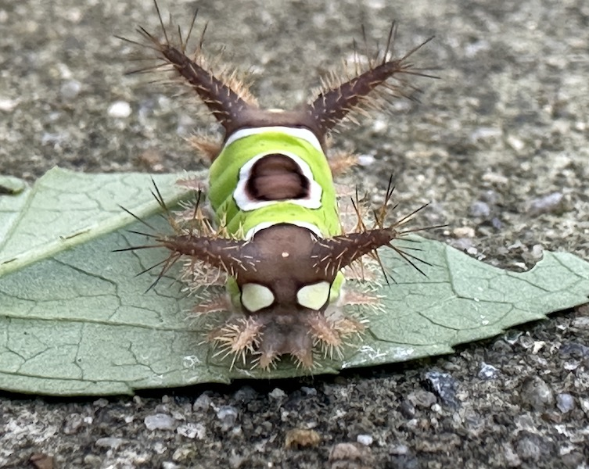
Don’t touch this
- Christina Wenks

Slide 31
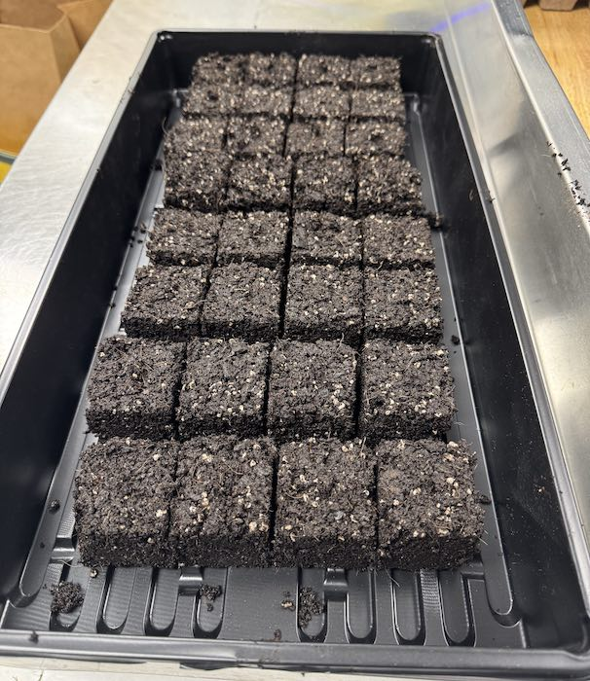
Soilblock
- Kim DiBona

Slide 32
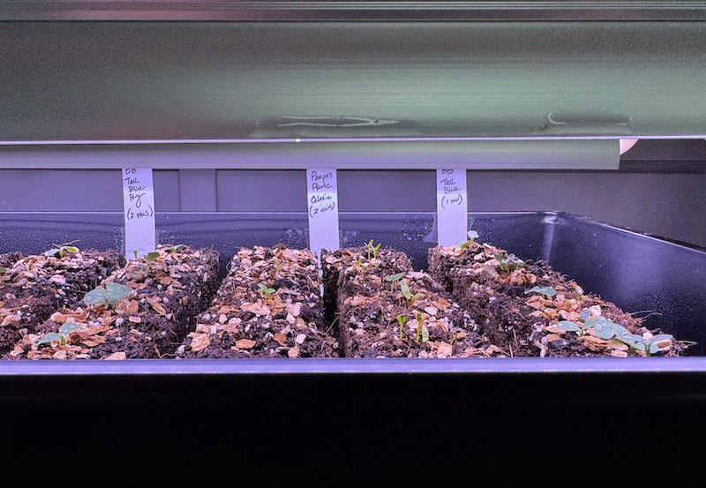
Soilblock
- Kim DiBona

Slide 33
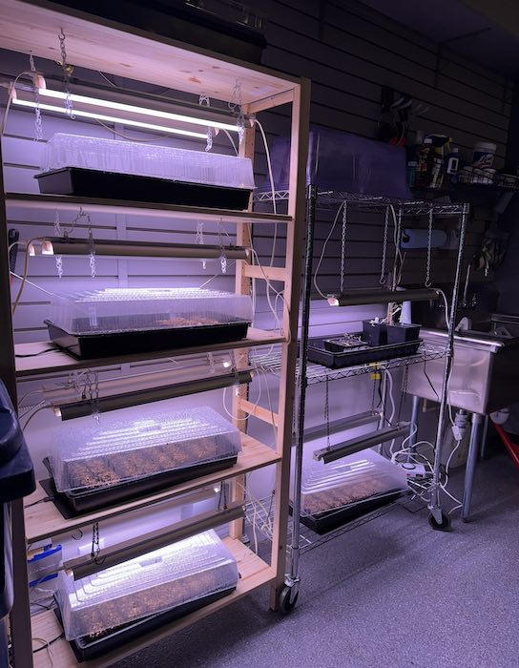
Soilblock
- Kim DiBona

Slide 34
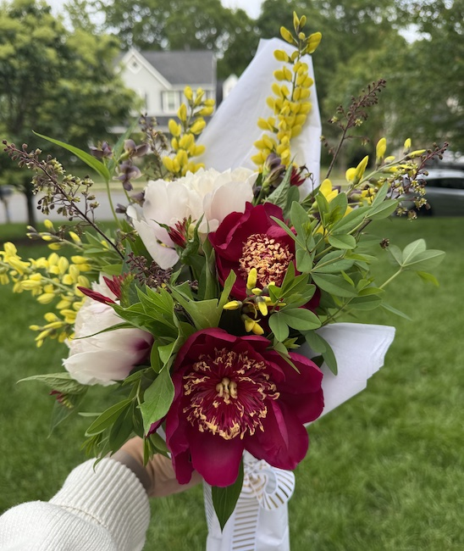
Spring Bouquet
- Kim DiBona

Slide 35
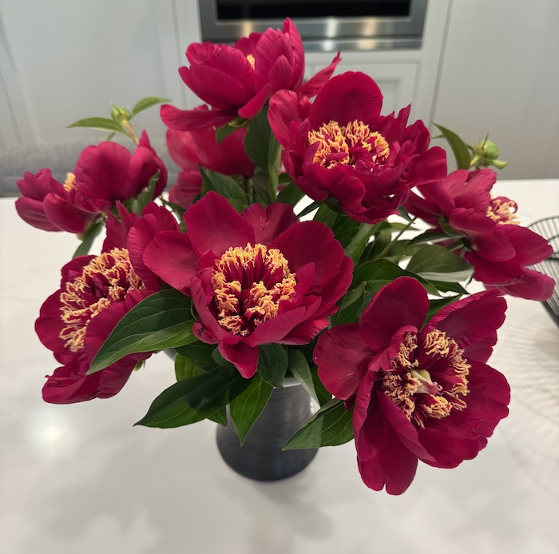
Spring
- Kim DiBona

Slide 36
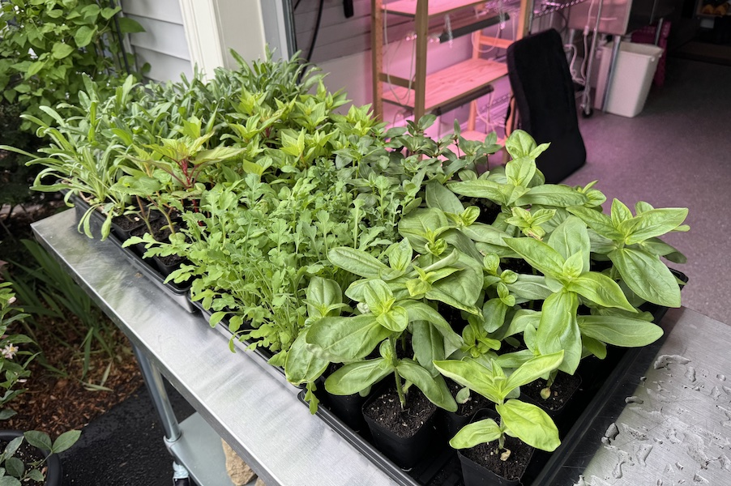
Seedlings
- Kim DiBona

Slide 37
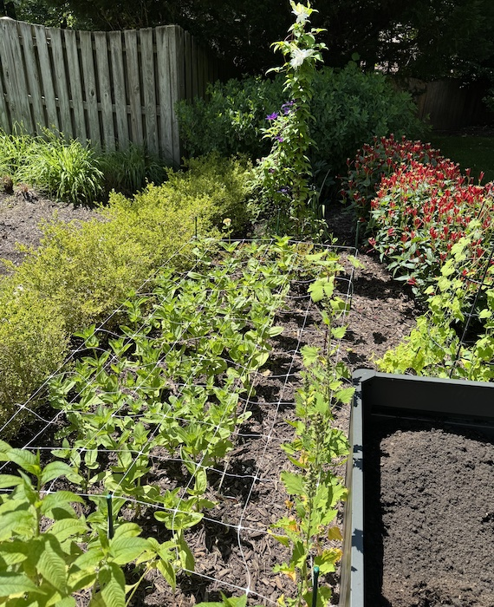
Bed
- Kim DiBona

Slide 38
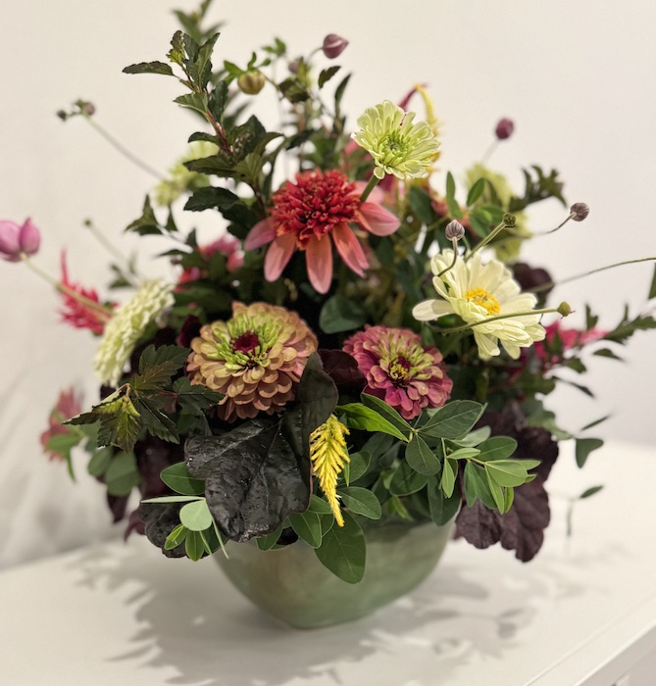
Bounty Arrangement
- Kim DiBona

Slide 39
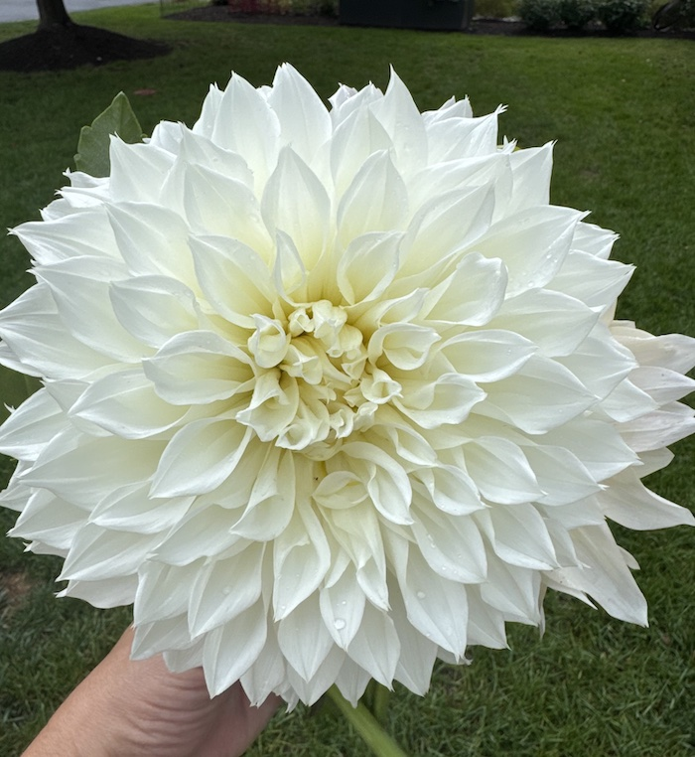
Dahlia
- Kim DiBona

Slide 40
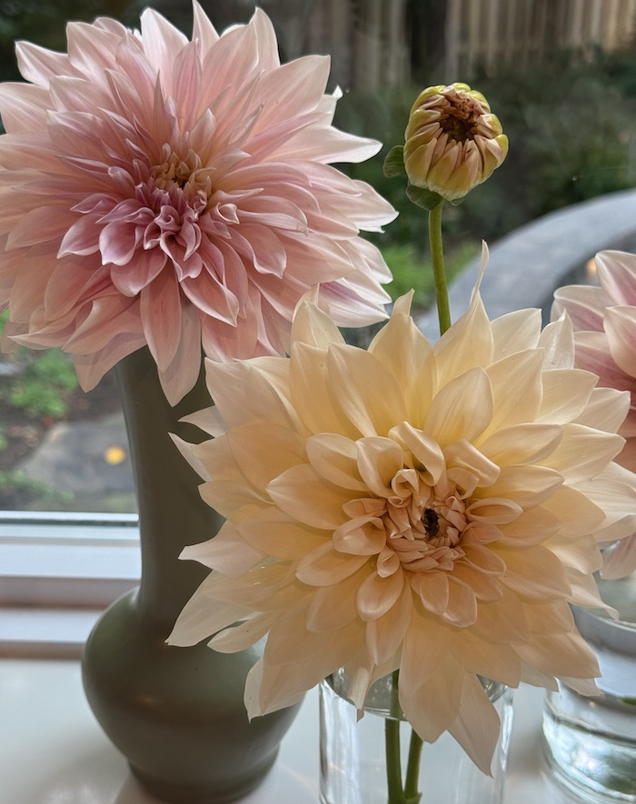
Dahlia
- Kim DiBona

Slide 41
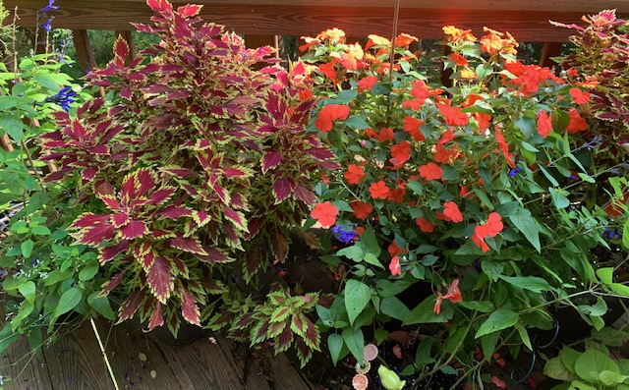
Deck container
- Lynne Pieri-Finn

Slide 42
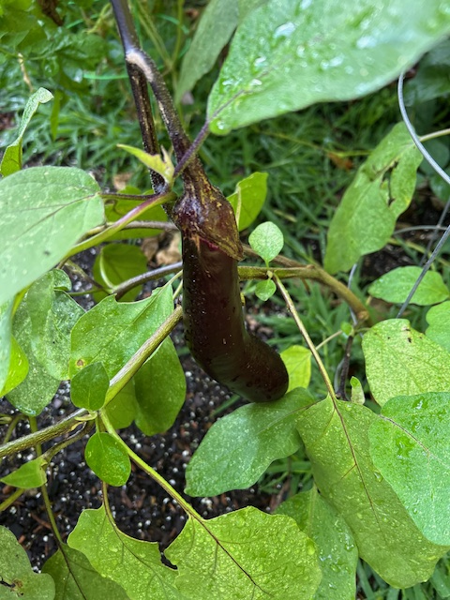
Eggplant
- Michele Bevington

Slide 43
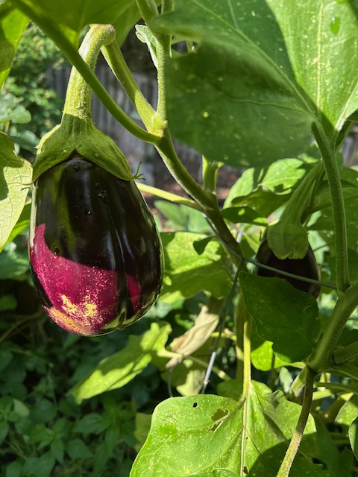
Eggplant
- Michele Bevington

Slide 44
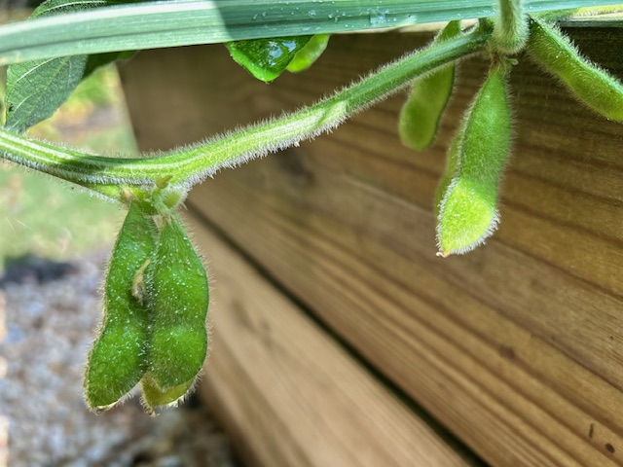
Edamame
- Michele Bevington

Slide 45
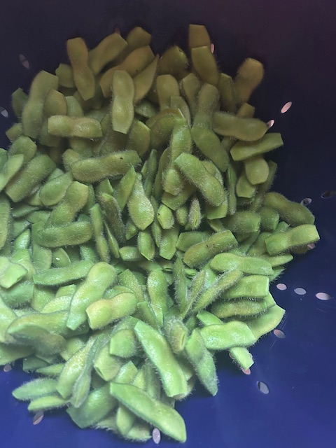
Edamame
- Michele Bevington

Slide 46
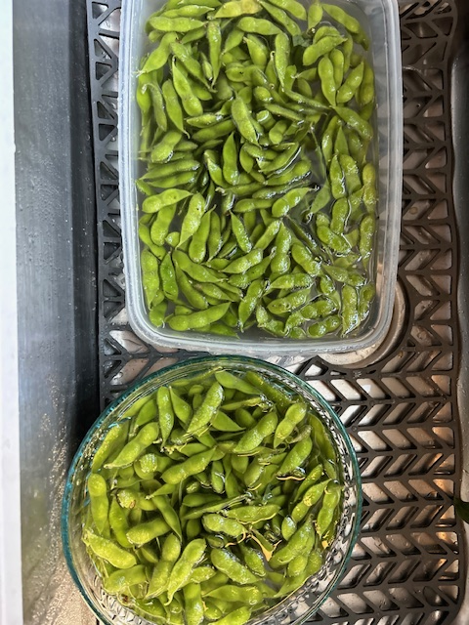
Edamame
- Michele Bevington

Slide 47
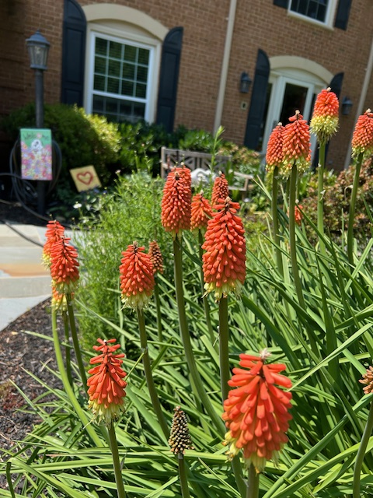
Fire poker
- Michele Bevington

Slide 48
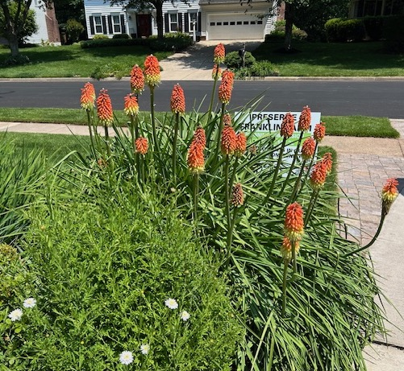
Fire poker
- Michele Bevington

Slide 49
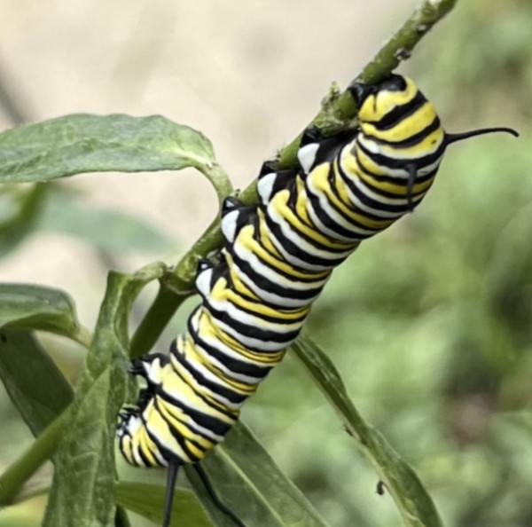
Monarch Butterfly Caterpillar
- Karen Bell

Slide 50
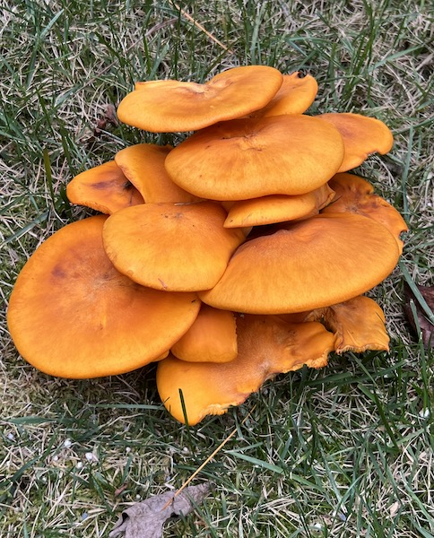
Orange Fungi
- Karen Bell

Slide 51
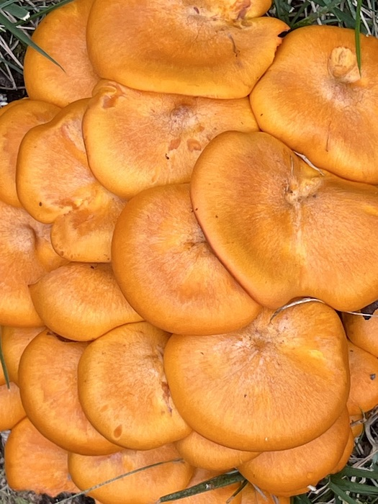
Orange Fungi Closeup
- Karen Bell

Slide 52
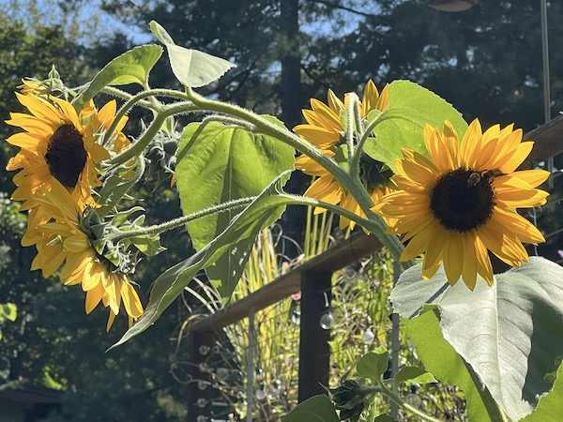
Sunflowers in the Sun
- Karen Bell

Slide 53

Dried Out
- Karen Bell

Slide 54

Baby/propagated Southern Magnolia
- Karen Bell

Slide 55

Rex Begonia
- Karen Bell

Slide 56

Purple Beautyberry
- Karen Bell

Slide 57

Wall and Pillars
- Janet Scheren

Slide 58

Stepping Stones
- Janet Scheren

Slide 59

Zinnia
- Pat Dickey

Slide 60

Dill Flower
- Pat Dickey

Slide 61

Cosmos
- Pat Dickey

Slide 62

Wall Iris from Japan
- Pat Dickey

Slide 63

Butterflies & Bees
- Sandra Oliver

Slide 64

Butterflies & Bees
- Sandra Oliver

Slide 65

Butterflies & Bees
- Sandra Oliver

Slide 66

Butterflies & Bees
- Sandra Oliver

Slide 67

Butterflies & Bees
- Sandra Oliver

Slide 68

Monarda fistulosa
‘Claire Grace’
- Terry Ginda

Slide 69

Aronia melanocarpa ‘Ground Hog’
Phlox divaricate ‘Blue Moon’
Packera aurea
- Terry Ginda

Slide 70

Iris cristata, Astilbe.
Azalea, Autumn Fern, Hellebores,
Japanese forest grass
- Terry Ginda

